Slide 1

Proxy Preview 2023
Download the full report at
www.proxypreview.org
March 22, 2023

Slide 2
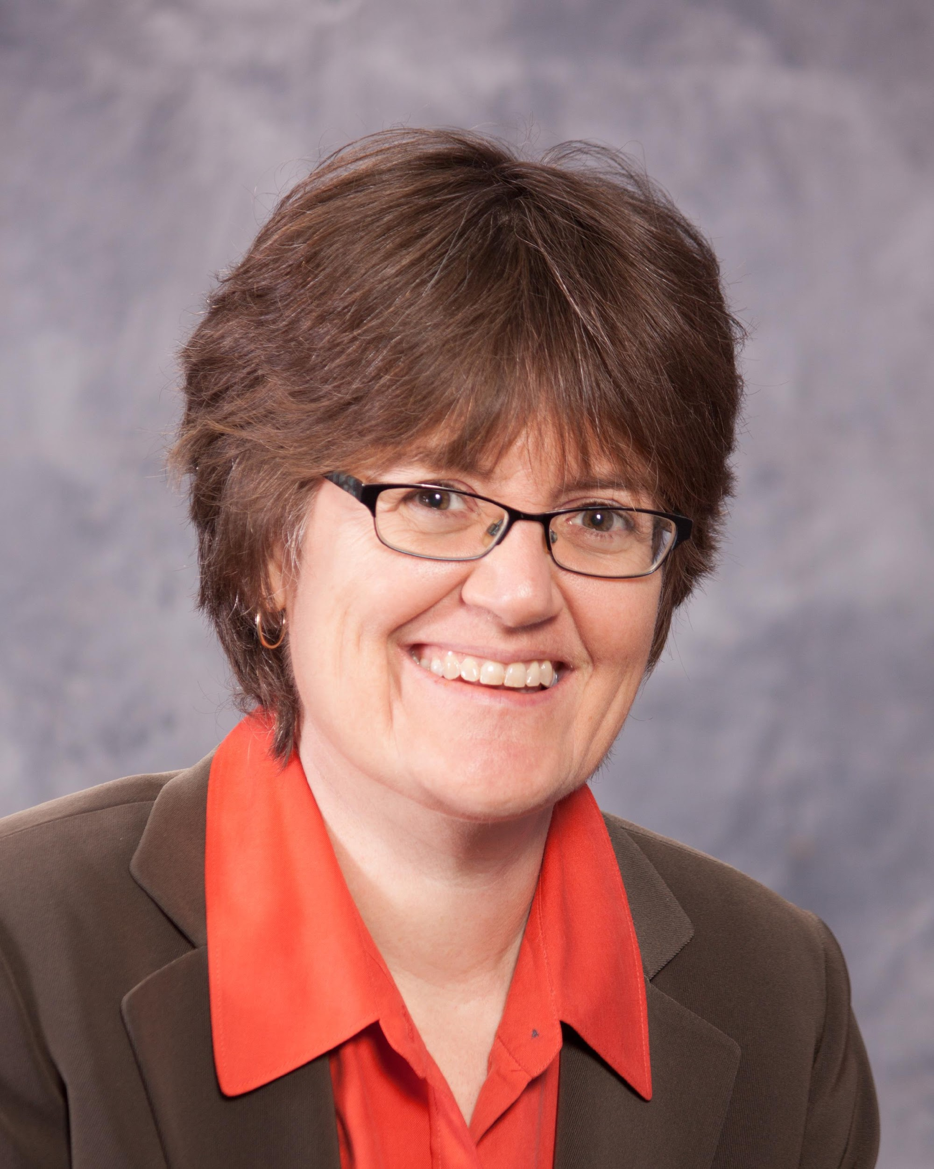
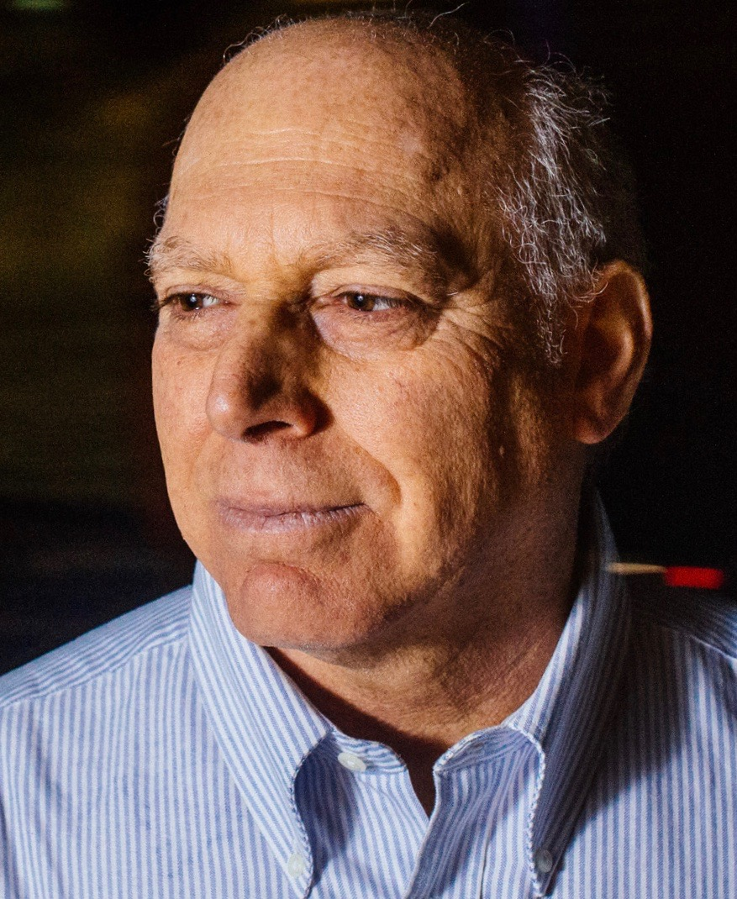
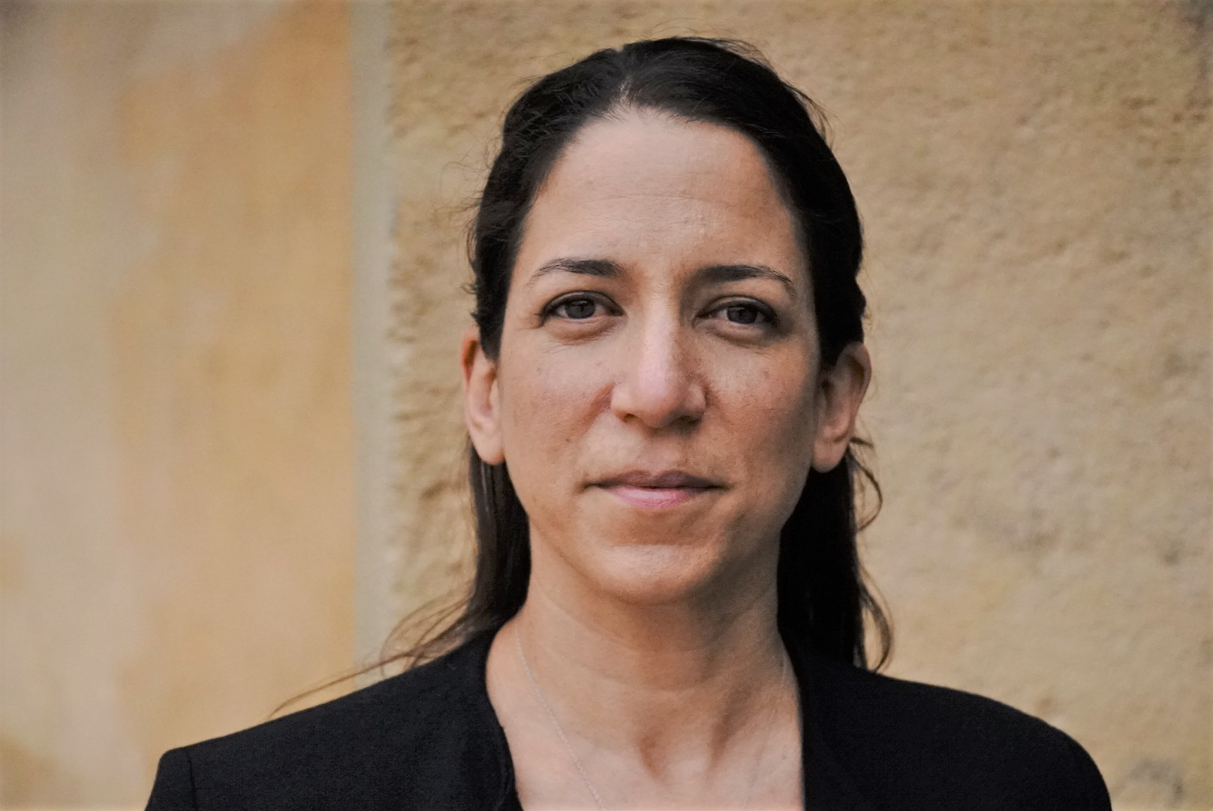
Featured Speakers
Heidi Welsh
Sustainable Investments Institute (Si2)
Michael Passoff
Proxy Impact
Meredith Benton
Whistle Stop Capital

Slide 3
Agenda
✓ Introduction (6 min)
Andrew Behar, As You Sow
✓ 2023 Proxy Season Overview (20 min)
Heidi Welsh, Si2
✓ Climate & Energy (10 min)
Michael Passoff, Proxy Impact
✓ Racial Justice and Human Rights Proposals (10 min)
Meredith Benton, Whistle Stop Capital
✓ Q&A (25 min)
moderated by Andrew Behar
✓ Closing Remarks (5 min)
Heidi Welsh, Michael Passoff, Meredith Benton
✓ Conclusion (2 min)
Andrew Behar
Notes:
Jenna, I changed it from climate to climate and energy

Slide 4
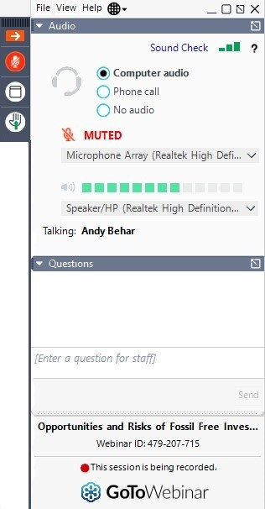
General Information
Use the Q&A window to send us your questions
Q&A Window
Download the full report at
www.proxypreview.org

Slide 5
About As You Sow
Mission: to promote environmental and social corporate responsibility through shareholder advocacy, coalition building, and innovative legal strategies
Founded in 1992 on the belief that corporations must be an active part of the solutions to society’s environmental and human rights issues
30-year track record of promoting values-aligned investing and securing positive, lasting corporation change
We communicate directly with corporate executives to collaboratively develop and implement business models that reduce risk, benefit brand reputation, and protect long-term shareholder value while simultaneously bringing about positive change for the environment and human rights

Slide 6
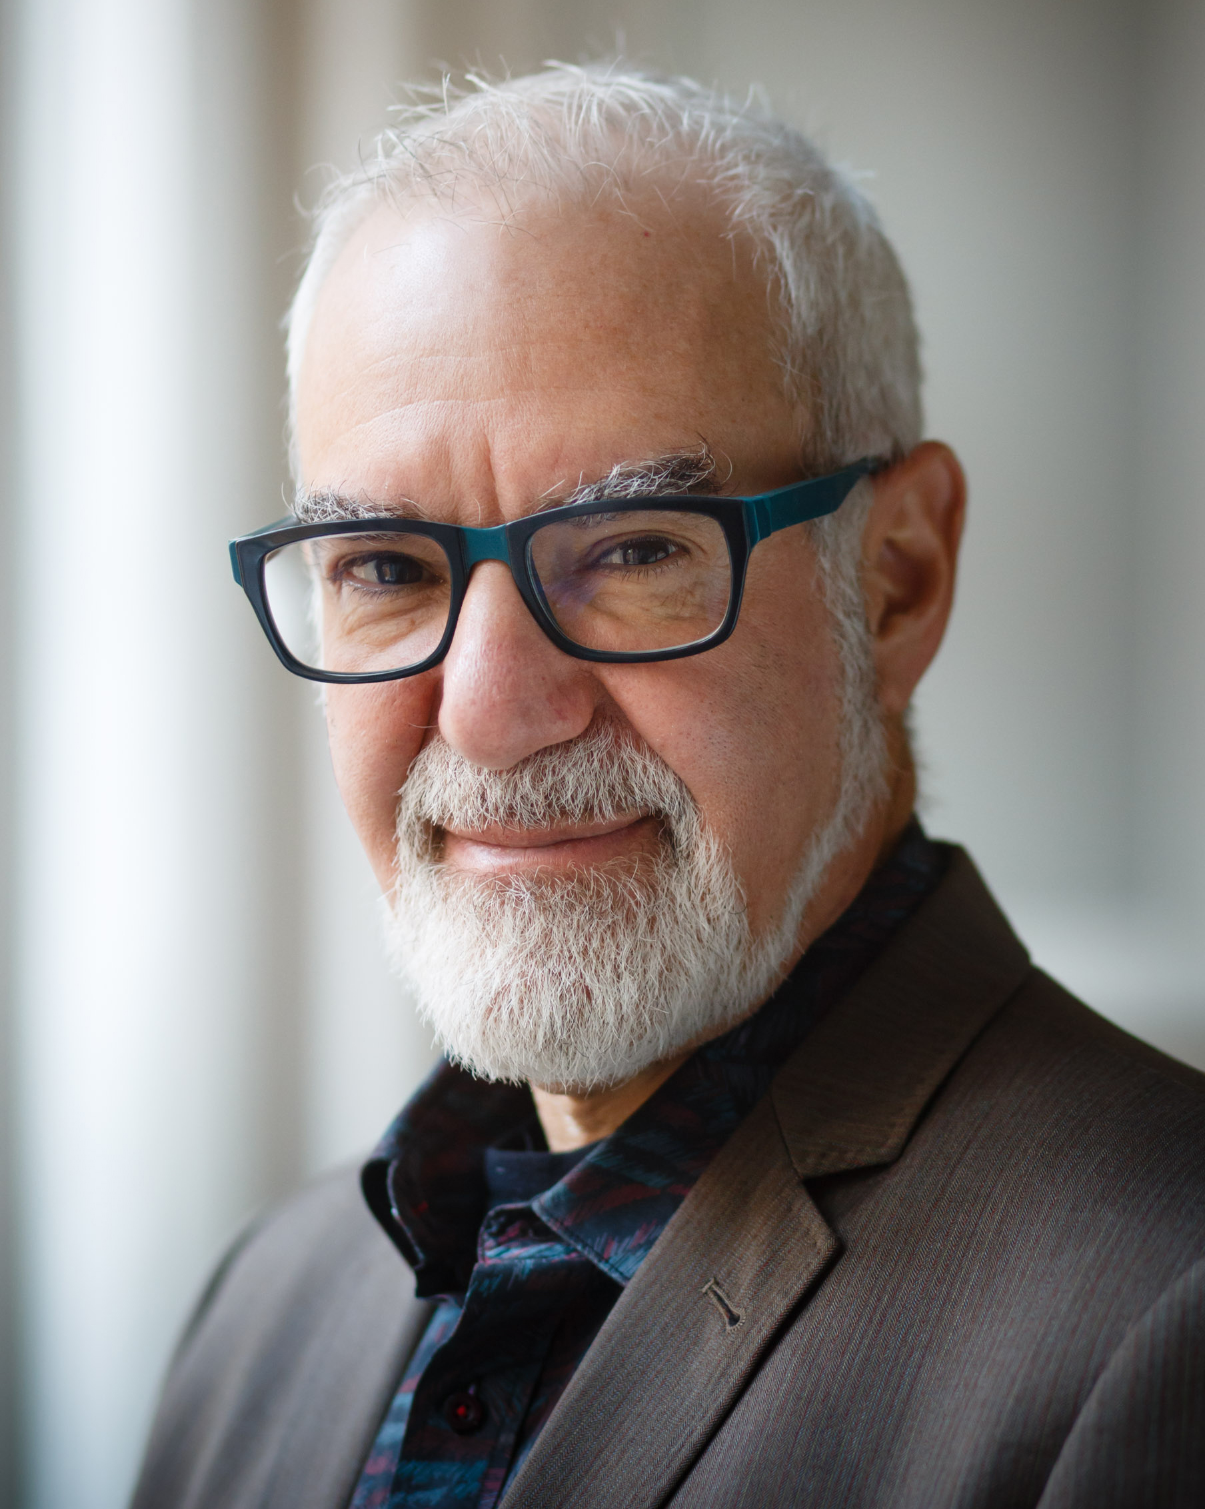

Introduction
Andrew Behar
CEO
As You Sow

Slide 7

2023 Proxy Season Overview
Heidi Welsh
Executive Director
Sustainable Investments Institute (Si2)

Slide 8
Notes:
Continued political $ focus: “connective tissue”

Slide 9
Support in 2022 fell, less if anti-ESG proposals excluded.
Fewer omissions continues given SEC approach.
Withdrawals grew in 2022, but record # of votes.

Slide 10
Outcomes Update
As of March 20:
Withdrawals will increase – how much?
424 pending – another record coming?
# voted in 2022 was up 60%
Omissions down sharply given SEC shift
Anti-ESG filings already even with 2022, possibly will hit 70

Slide 11
Outcomes of SEC No Action Challenges
As of March 20:
Challenges about 30% of total filed until 2021
About 50% success rate for companies until 2021
Company success rate 25% or less in last 2 years
Result: fewer challenges
50 letters not decided yet for spring proxy season

Slide 12
Majority Votes

Slide 14
Past and Projected Votes – Top Issues
(projected)

Slide 15
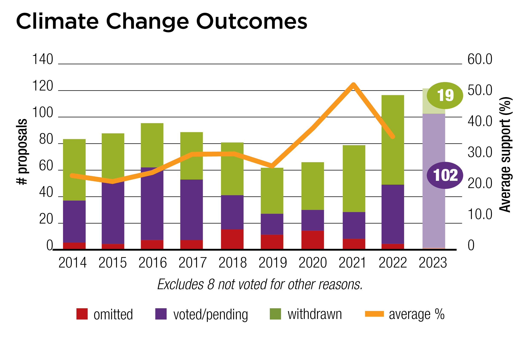
New Issues, Key Themes in 2023
Environment
Climate Change (122 proposals, up from 110 last year)
  Consistent focus on GHG emissions targets, reporting
  More on strategy & risk assessment
  Deforestation concerns persist
NEW:
Climate finance limits less specific compared to 2022
Emissions accounting methods, asset retirement obligations
Impacts on water, “just transition”

Slide 16
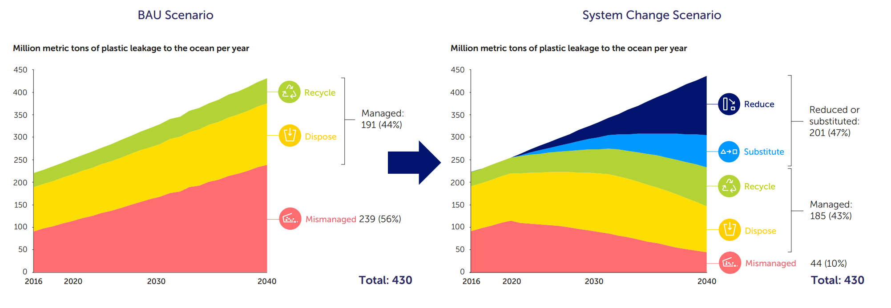
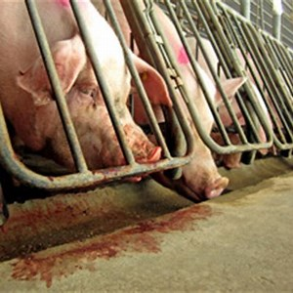
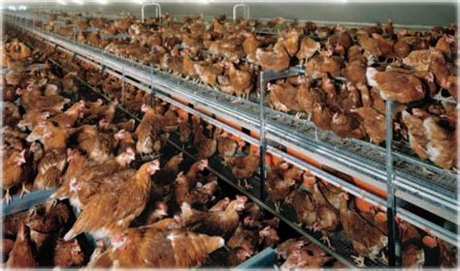
New Issues, Key Themes in 2023
Environment
Environmental Management (38, down from 52 last year)
  Waste/Pollution — mostly on plastic production & use
  NEW: “Circular economy” at Constellation Brands
    Agriculture — More on eggs, chicken & pig welfare
    NEW: plant-based milk – Starbucks
Breaking the Plastic Wave Projection for Needed System Change

Slide 17


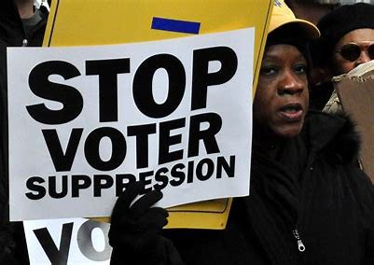

New Issues, Key Themes in 2023
Social Issues
Corporate Political Influence (about 90, 1/3 on values)
        Oversight/disclosure model for election/lobbying
        NEW: Reporting on intermediaries’ spending
        Values: Company policy vs. supported political player priorities
          SHIFT: Climate-related lobbying more specific
          MORE: Reproductive rights, voter suppression questions

Slide 18




New Issues, Key Themes in 2023
Social Issues
Decent Work (just under 50 proposals, down from 70+ last year)
    Fair pay (20): Almost all on gender/racial pay gaps
    Working conditions (17): details on fair treatment, health & safety
      NEW: Audit performance, address gun violence at work
    Benefits (8): Paid sick leave – OK’d by SEC last year
      NEW: Transgender health benefits at LKQ

Slide 19



New Issues, Key Themes in 2023
Social Issues
Diversity at Work (38, down from 50 last year)
  More disclosure on DEI = fewer proposals – 40 withdrawn in 2022
  New target companies in 2022
  NEW: Criminal record impact on hiring (4 companies)

Slide 20



New Issues, Key Themes in 2023
Social Issues
Health (big expansion: 41 proposals, up from 24 in 2022)
  Reproductive rights
  Roe v. Wade overturned in June 2022, has prompted many restrictions, more questions about risks.
    NEW ANGLES:
      Digital privacy at financial firms, social media companies
    Insurance coverage for reproductive health
    Abortion access at hospitals, miscarriage care
    Maternal healthcare access and outcomes
      Health equity
      NEW: race-based outcome disparities (NYSCRF)
      Pharmaceuticals
      More specific on “patent thickets”
      Resubmitted Covid proposals

Slide 21

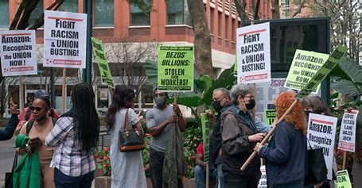

New Issues, Key Themes in 2023
Social Issues
Human Rights (79, down from 91 last year), 67 pending mid-February
      Racial justice/civil rights: audits earned 8 majorities in 2022, half of 24 pending proposals are resubmissions.
      Policy/risk assessment (12) & problem locations/products (6)
        — China, military & guns, supply chain labor
        NEW: Texas Instruments tech in Ukraine?
    Domestic trade union rights (12)
    NEW: Adopt policy/report on ILO/UN standards
      — Early agreement at Apple (NYC Comptroller)
    Media & technology (11) on content, privacy
    NEW: Impending YouTube regulation in Europe, Political extremism in India

Slide 22

New Issues, Key Themes in 2023
Sustainable Governance
Board composition and oversight (35)
  NEW: Board assessment of staffing adequacy at HCA Healthcare (IL Treasurer)
Sustainability
  ESG pay links (7)
  NEW: link to maternal mortality - Molina Healthcare
  Investment practices (7)
  MORE: climate-friendly retirement plans

Slide 23
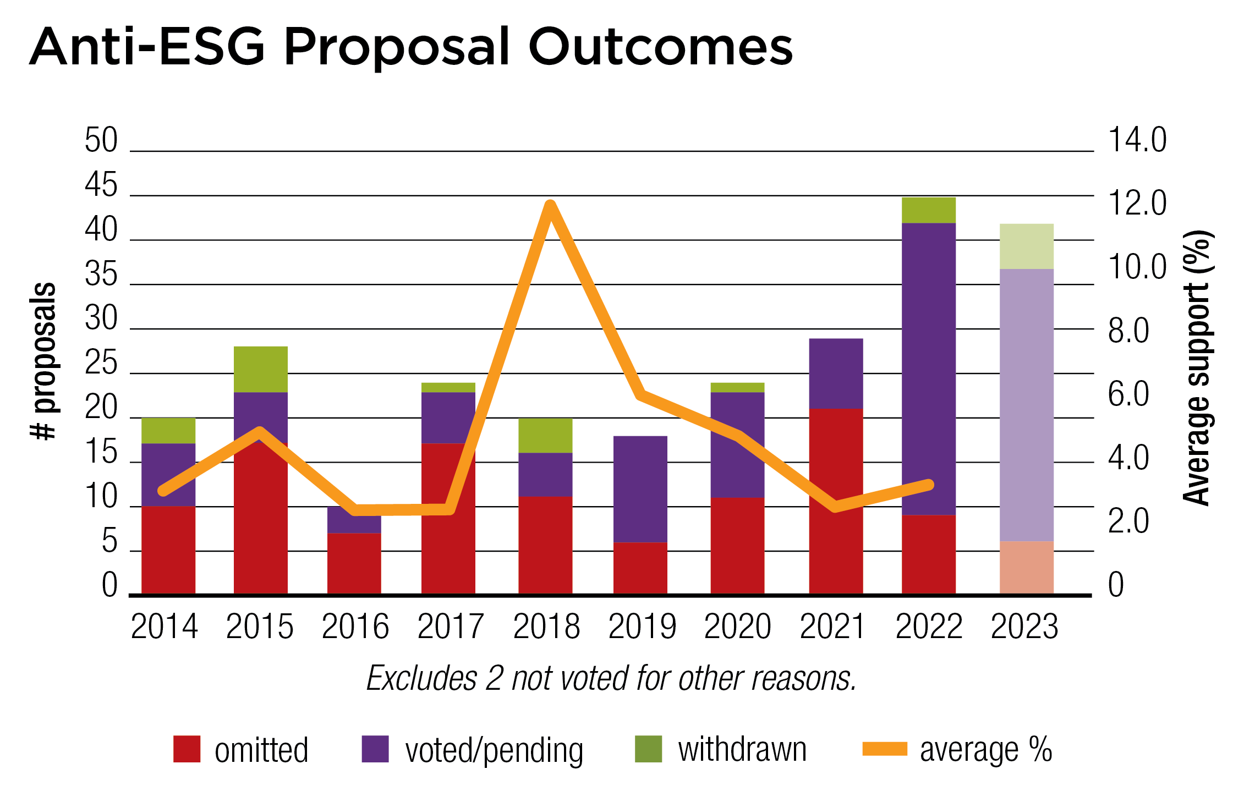
New Issues, Key Themes in 2023
Anti-ESG
Increase: Filings up 60% as of February – 47, may hit 70
Low support: Average below 5%, bump-up in 2018 from copying political spending proposals.
↑
Social policy focus (35)
  Risks of DEI, racial justice programs
  China: Despite shared concerns, 4.3% at Apple
  Political influence (11)
    NEW: Cut ties to “political” groups (World Economic Forum, Business Roundtable)

Slide 24
About Si2
Funded by colleges, universities, pension funds, asset owners with AUM > $5 trillion
Careful, impartial tracking and analysis of corporate reform campaigns and issues
Briefing Papers
  In-depth topic analyses
Action Reports
    Company-specific analysis 3-4 weeks before annual meetings
Engagement Monitor
Interactive online database
Prospectively identifies issues
Tracks outcomes
Proxy Season Analysis
Pre- and post-season assessments
Weekly email updates in season
Special Projects
Reports for the public on Si2 website on corporate political activity, climate change, integrated reporting and more.
Contact
Heidi Welsh, Executive Director
heidi @ siinstitute.org
+1-301-432-4721
www.siinstitute.org

Slide 25

Climate and Energy
Michael Passoff
CEO
Proxy Impact

Slide 26
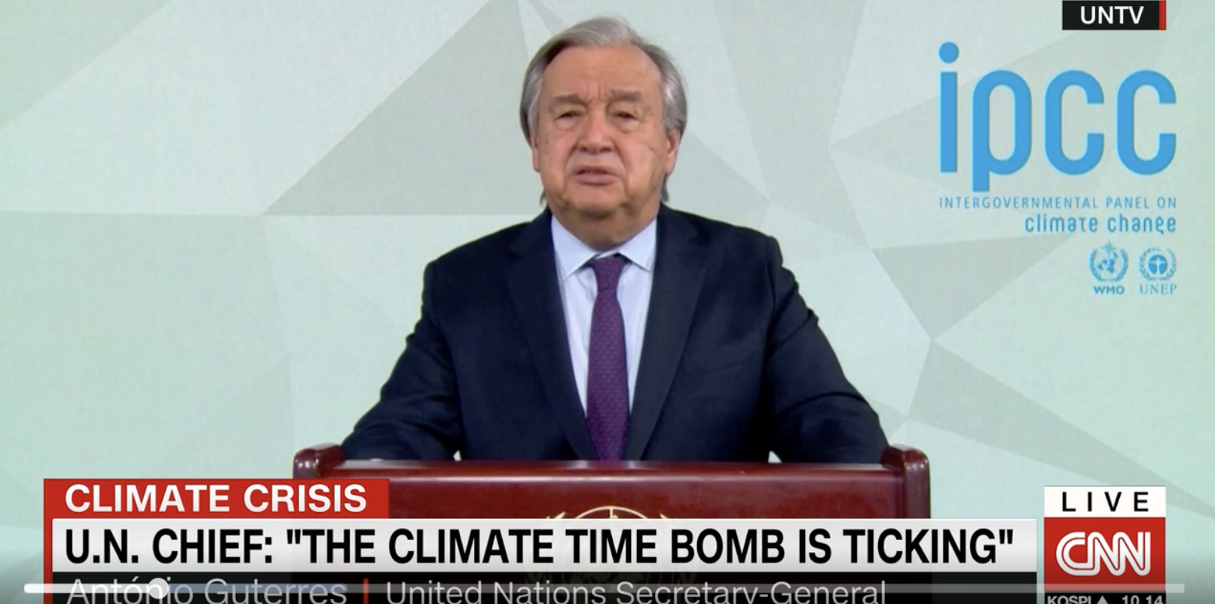
Intergovernmental Panel on Climate Change (IPCC)
Latest Report l
IPCC previously called for 43% cut by 2030 (assumed peak emissions by 2025)
Current national pledges project 10.6% increase by 2030
2022: global emission grew 0.9%
Now need 60% reduction by 2035
Very steep cuts over next decade
New fossil fuel projects China, India, US
1.5C achievable, need to ”massively fast track climate efforts”

Slide 27



Greenhouse Gas Emissions Reduction
Adopt / Report on:
Net Zero Goals
GHG Reduction Targets
Paris Compliant Plan
Scope 3 Emissions
Expectations
Climate Action 100+
UN Environment Program
Science-Based Target initiative

Slide 28

SEC Climate Disclosure Rule
March 2022: SEC Proposes Rules to Enhance and Standardize Climate-Related Disclosure
Would require U.S. publicly traded companies to disclose annually how their businesses are assessing, measuring and managing climate-related financial risks
Builds upon Task Force on Climate-related Financial Disclosures (TCFD)
Canada, Japan, New Zealand, Sweden, UK already have mandated TCFD-aligned climate-related financial disclosures
S&P 500: 50%+ disclose climate risks and 71% disclose GHG emissions
Final rule expected Spring 2023

Slide 29
Emissions Financing and Underwriting
Banks
Proposals asks: “a transition plan” on how each “intends to align its financing activities with its 2030 sectoral greenhouse gas emissions reduction targets,”
Resubmitted proposals
  Bank of America, Goldman Sachs, JPMorgan Chase, Morgan Stanley and Wells Fargo
New proposals
  Huntington Bancshares, PNC Financial
Net Zero Banking Alliance
  40% of global banking assets.
Insurers
Proposals ask: measure, disclose, and set net-zero targets for their underwriting and investing activities
2nd yr proposals
  Chubb 72.2%
  Travelers 55.8%
  Berkshire Hathaway 25% (46% of non-management controlled vote)
The Hartford
  Commits to Net Zero
Net Zero Insurance Alliance
  30% of global insurers

Slide 30

New: Transferred Assets
Exxon, Chevron
Provide accurate GHG reporting; recalculate baseline emissions to exclude asset transfers
Oil and gas industry association recommends:
“adjustments to the base year emissions” to account for asset transfers, to avoid giving the appearance of “increases or decreases in emissions, when in fact...emissions would merely be transferred from one company to another.”

Slide 31

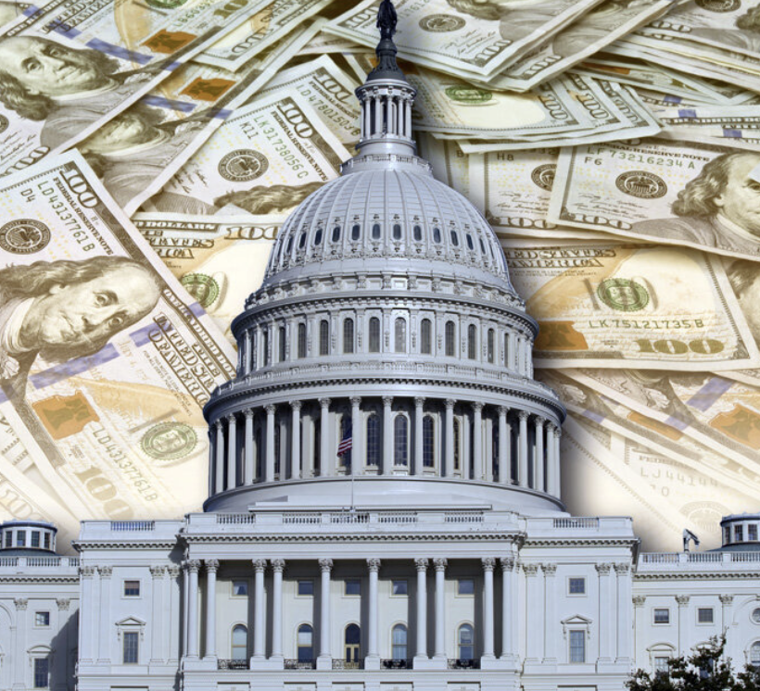
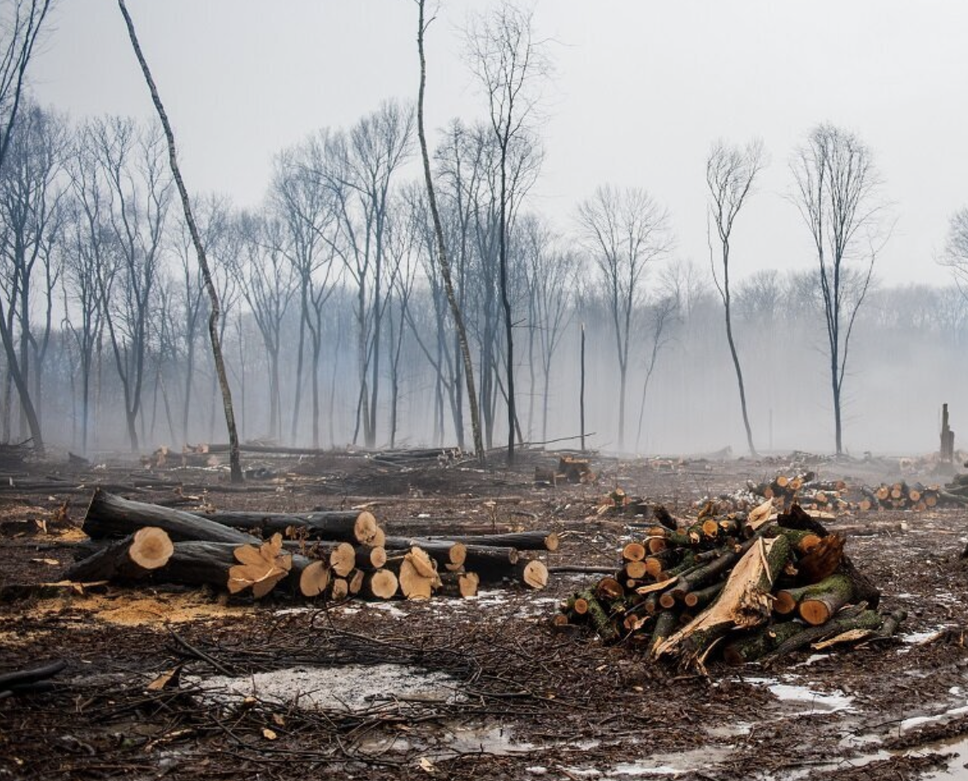

Ongoing Efforts
Deforestation
Methane
Plastics - Petrochemicals
Climate Lobbying

Slide 32

___________________________________________________________________
A proxy voting and shareholder engagement service for
sustainable and impact investors
    ESG vote guidelines
    Proxy voting and reporting
    Shareholder engagement on social & environmental issues
  Contact Michael Passoff, michael@proxyimpact.com www.proxyimpact.com

Slide 33

Social Topics: Rising issues and shifting winds
Meredith Benton
Principal and Founder
Whistle Stop Capital

Slide 34

Political influence
Lobbying and trade association memberships
Election spending
Direct and indirect influence
Values congruency
  Climate
  Health
  Equality
  Democracy
  …etc

Slide 35


Acknowledging complexity: values congruency
Are companies managing for the intended and unintended outcomes of their political engagement?
Withdrawal example:

Slide 36
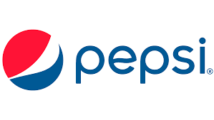

Heading to Ballot
“We aren’t political”
but politics have come for them.
74% of women can imagine a situation in which they, or someone covered by their insurance, would need an abortion
Women spend about three-quarters of their reproductive life trying to avoid pregnancy
12 states have made abortion illegal. Up to 13 more are expected to
1 in 4 women have had an abortion by the age of 45 ( > 60% already are parents)
Almost 90% say controlling when and if to have children has been important to their careers
Source: Rhia Ventures

Slide 37









The move towards greater transparency
20 agreements reached, including:
Learning from workplace diversity and inclusion data disclosure
  Link to business strength
  Standardized indicators
  Encouragement of additional reporting unique to the specific company
Need: Time between sharing expectations and corporate disclosure.
Russell 1000 reporting commitments, Jan’22 –’23:
EEO-1: 134% (over 30%)
Hiring: 59% (gender disclosure over 20%)
Promotion: 98% (gender disclosure over 7%)
Retention: 70% (gender disclosure over 11%)

Slide 38
___________________________________________________________________
A consultancy that works with asset owners and advisors to assess, and address, social and environmental exposures within their investment portfolios.
    Supported shareholder engagements
    Issue and portfolio assessments
    Corporate benchmarking and data insights
  Contact Meredith Benton, Benton@whistlestop.capital, whistlestop.capital

Slide 39
Questions and Answers
Use the Q&A window to send us your questions
Michael Passoff
Proxy Impact
Heidi Welsh
Sustainable Investments Institute (Si2)
Q&A Window
Meredith Benton
Whistle Stop Capital

Slide 40
Closing Remarks
Heidi Welsh
Sustainable Investments Institute (Si2)
Michael Passoff
Proxy Impact
Meredith Benton
Whistle Stop Capital

Slide 41


More on www.proxypreview.org
Download Proxy Preview 2023
Sign up to follow Proxy Season Updates
Watch a recording of this presentation
Meet the contributing authors
Learn more about shareholder advocacy

Slide 42
Contact Us
Media/Press Contact
Stefanie Spear
(216) 387-1609
sspear@asyousow.org
Download the report at
www.proxypreview.org

Slide 43
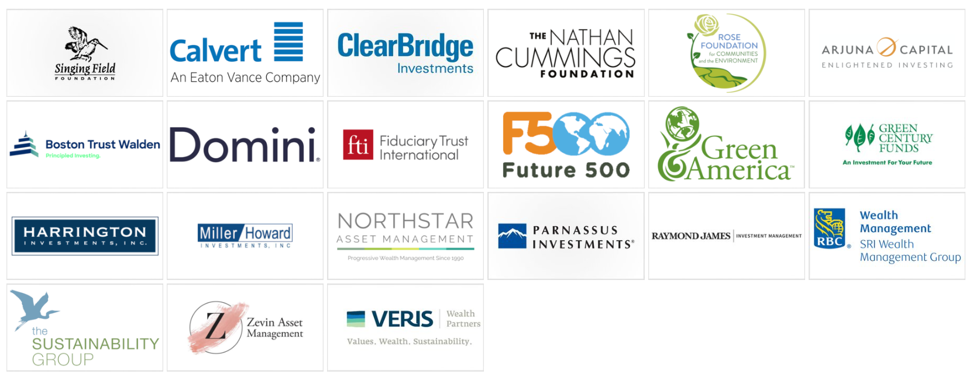
Thank you to our sponsors!

Slide 44
DISCLAIMER
The aggregated information comprising Proxy PreviewTM 2023 represents a snapshot in time of publicly available information regarding shareholder resolutions filed with U.S. public companies that may be on the proxy statements and voted on at annual general meetings in 2023.
The information provided in Proxy PreviewTM 2023 is provided “AS IS” without warranty of any kind. The three partner organizations, As You Sow, Sustainable Investments Institute, and Proxy Impact, each makes no representations and provides no warranties regarding any information or opinions provided herein, including, but not limited to, the advisability of investing in any particular company or investment fund or other vehicle. While we have obtained information believed to be objectively reliable, neither As You Sow, Sustainable Investments Institute, or Proxy Impact, or any of each of their employees, officers, directors, trustees, or agents, shall be responsible or liable, directly or indirectly, for any damage or loss caused or alleged to be caused by or in connection with use of or reliance on any information contained herein, including, but not limited to, lost profits or punitive or consequential damages. Past performance is not indicative of future returns.
As You Sow, Sustainable Investments Institute, and Proxy Impact do not provide investment, financial planning, legal or tax advice. We are neither licensed nor qualified to provide any such advice. The content of our programming, publications and presentations is provided for informational and educational purposes only, and should not be considered as information sufficient upon which to base any decisions on investing, purchases, sales, trades, or any other investment transactions. We do not express an opinion on the future or expected value of any security or other interest and do not explicitly or implicitly recommend or suggest an investment strategy of any kind.
Our events, websites, and promotional materials may contain external links to other resources, and may contain comments or statements by individuals who do not represent As You Sow, Sustainable Investments Institute, and Proxy Impact. As You Sow, Sustainable Investments Institute, and Proxy Impact each has no control over, and assumes no responsibility for, the content, privacy policies, or practices of any third party websites or services that you may access as a result of our programming. Each of As You Sow, Sustainable Investments Institute, and Proxy Impact shall not be responsible or liable, directly or indirectly, for any damage or loss caused or alleged to be caused by or in connection with use of or reliance on any such content, goods or services available on or through any such websites or services.
Copyright © 2023 As You Sow, Sustainable Investments Institute, and Proxy Impact. All rights reserved. This publication is protected by U.S. and International copyright laws. Reproduction and/or distribution of this publication, in whole or in part, without permission of the authors is prohibited.

Slide 45
Thank You for Joining Us!
Download the full report at
www.proxypreview.org
March 22, 2023

